Slide 1
The Annotation Pipeline
-Srini
Notes:
There are a lot of assumptions that we have made throughout the process……important……may affect individual’s analysis

Slide 2
Creation of the Dictionary
Annotation using the dictionary
Annotation post-processing to generate the nid_cid tables
Discuss sharing/versioning…

Slide 3
Dictionary Preparation
/ncbodata/emr/dictionaries/dictionary3/
Collect a list of terms
Process and pick unique terms(assign tids)
Annotate and get frequencies
Reassign tids based on frequencies

Slide 4
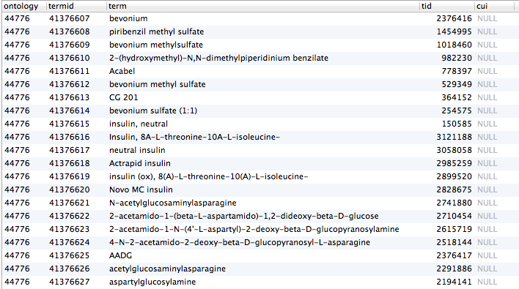
terminology3.terms

Slide 5
Dictionary Preparation
18 Bioportal Ontologies (obs_hibernate_mar2011)
16 UMLS Ontologies (umls2011ab.MRCONSO)
ATC (terminology3.atc2str)
ConText (dictionary3/context/context-dict-final.txt)
Punctuations
Headings

Slide 6
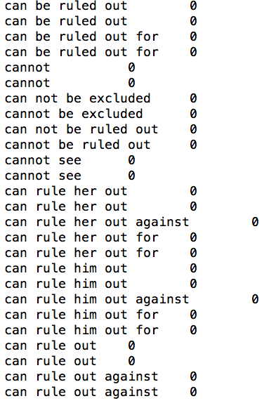
Context

Slide 7
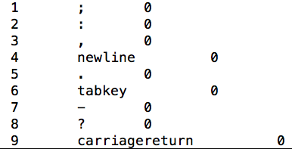
Punctuations

Slide 8
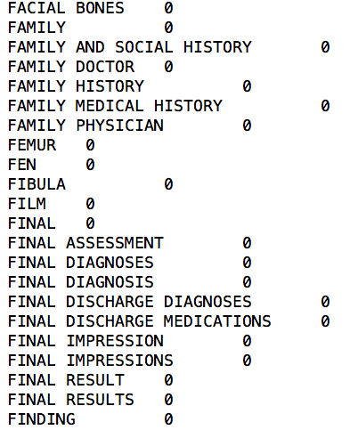
Headings (prepared by Cedrick)

Slide 9
Dictionary Processing
Replace special characters
Remove Single-character terms
Remove {Stop Words}\{Negation terms}
Remove Numerical terms
Retain Unique terms (trim and lowercase)
Assign term-ids based on term frequency

Slide 10
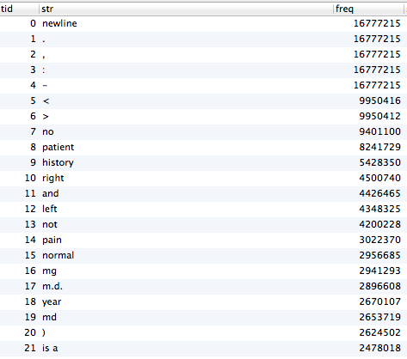
terminology3.str2tid
Notes:
The freq column

Slide 11
The Annotator
Latest version at
/ncbodata/emr/annotator/annotator-workflow-1.2-mysql/
Usage:
perl launch.pl <project_name> <start_num> <end_num> <chunksize> <instances> [- longest]
E.g. perl launch.pl pitt 1 93000 10000 4
Set db parameters in fetch.pl
Set dictionary path in annotate.pl
Requires a mysql table with nid(contiguous), text
Notes:
Annotator hasn’t changed for 6 months

Slide 12
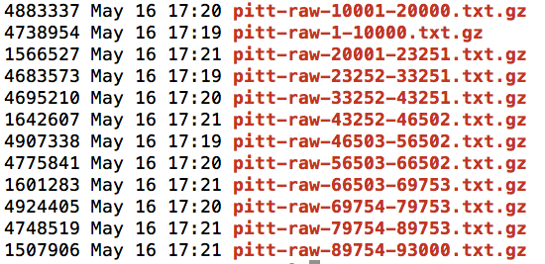
Annotator Output

Slide 13
Stride v4: /ncbodata/emr/stride/data/4.0/mgrep/output20111122.tar
PAMF: /ncbodata/emr/pamf/cast_annotation/{YEAR}

Slide 14
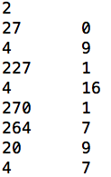
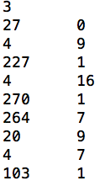
Inside the .txt.gz
All matches
Heart (tid: 23)
Heart Attack (tid: 25)
nid
First term has 0 offset
Offset from previous term
tid

Slide 15
Post Processing
Path: /ncbodata/emr/postprocess
gunzip –c /path/to/gz/*.gz | postprocess.sh
OR
gunzip –c /path/to/gz/*.gz |
perl create_row_format.pl |
python negex.py dictionary3-rh.txt negex_trig_new.txt |
python family_history.py dictionary3-rh.txt familyHistoryHeadings.txt |
python family_history_again.py dictionary3-rh.txt family_names.txt |
python convert_to_col_nf.py |
python remove_family_and_negated.py |
python rxnorm_rewrite.py

Slide 16
create_row_format.pl
2 27 0 4 9 227 1 4 16 270 1 264 7 20 9 4 7
negex.py
2 27 0 N4 9 N227 1 4 16 N270 1 264 7 20 9 4 7
family_history.py or
family_history_again.py
stride4.mgrep_nf_revised
2 27 0 N4 9 FN227 1 4 16 N270 1 264 7 F20 9 F4 7
2 27 0 0 0
2 4 9 1 0
2 227 10 1 1
2 4 26 0 0
2 270 27 1 0
2 264 34 0 0
2 20 43 0 1
2 4 50 0 1
convert_to_col_nf.py

Slide 17
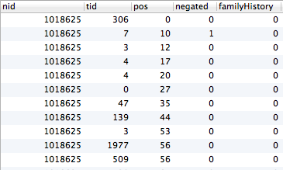
stride4.mgrep_nf_revised

Slide 18
Negex
Read Negex triggers (negex_trig_new.txt)
sufficient to rule him out for [PREN]
sufficient to rule her out for [PREN]
sufficient to rule the patient out for [PREN]
sufficient to rule out against [PREN]
sufficient to rule him out against [PREN]
sufficient to rule her out against [PREN]
sufficient to rule the patient out against [PREN]
rule out [PREP]
r/o [PREP]
ro [PREP]
rule him out [PREP]
rule her out [PREP]

Slide 19
Negex
Read a sentence (. ; : \n\n \r\n\r\n)
Flag terms with pre negation
No evidence of Uveitis
Flag terms with post negation
Uveitis can be ruled out

Slide 20
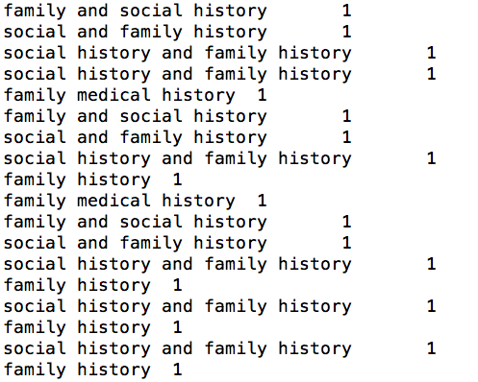
Family History - I

Slide 21
Family History - I
Family History : family history of Uveitis.
brother alcohol. Mother has history of arthritis .
Clinical History: is a year old woman …………………………………………………………………………………………………

Slide 22
Family History - II
family_names.txt
father
dad
mother
mum
mummy
mom
parent
parents
child
children
son
daughter
brother
sister
grandfather
Read a sentence
If it contains a family word
Flag the entire sentence

Slide 23
stride4.mgrep_nf_revised
Nid Cid
2 16260
2 394305
2 626293
2 5101
2 121381
2 120643
2 16539
2 19347
2 4625
2 27 0 0 0
2 4 9 1 0
2 227 10 1 1
2 4 26 0 0
2 270 27 1 0
2 264 34 0 0
2 20 43 0 1
2 4 50 0 1
remove_family_and_negated.py
tid2cid
user_sviyer.mgrep2cid_nid_cid_nf_revised
Nid Cid
2 296030
2 182657
2 16811
2 16260
2 18312
2 9481
2 10124
2 352013
2 134286
rxnorm_rewrite.py

Slide 24
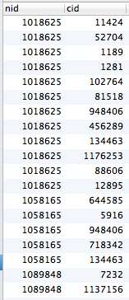
user_sviyer.mgrep2cid_nid_cid_nf_revised

Slide 25
Delete Negated & FH
Convert tid to cid
Remove all cid rows for which FH = 1
Remove any cid completely for which N = 1

Slide 26
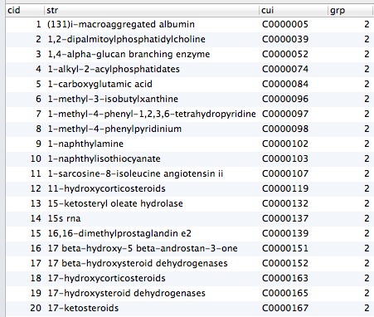
terminology3.str2cid

Slide 27
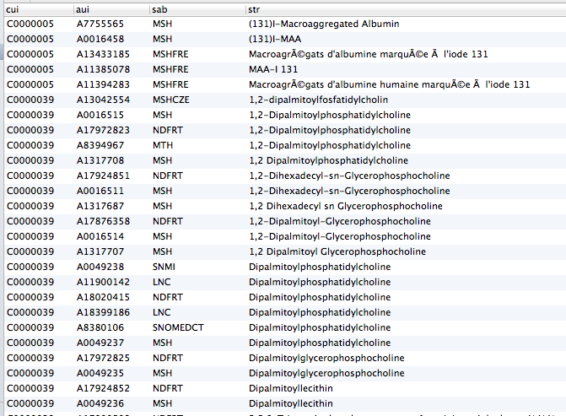
terminology3.tid2cid
(from umls2011ab.MRCONSO)

Slide 28
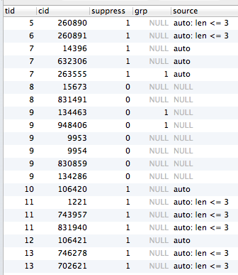
tid2cid (from umls2011ab.MRCONSO)
terminology.tid2cid
Suppress terms with
<=3 chars
Manually suppress
terms
Prefer one cid to
another

Slide 29
I don’t like cids!
Use slice ids
Use tid2sliceid in scripts
Begin at mgrep_nf_revised

Slide 30
Other Tables/Scripts
terminology3.isaclosure
terminology3.cidrewriting
postprocess/[freq1.py | freq2.py ]

